Slide 1

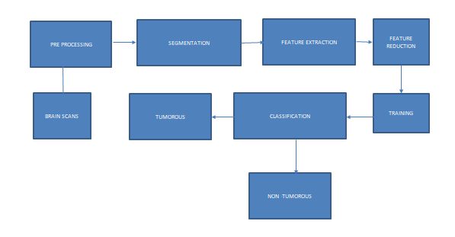
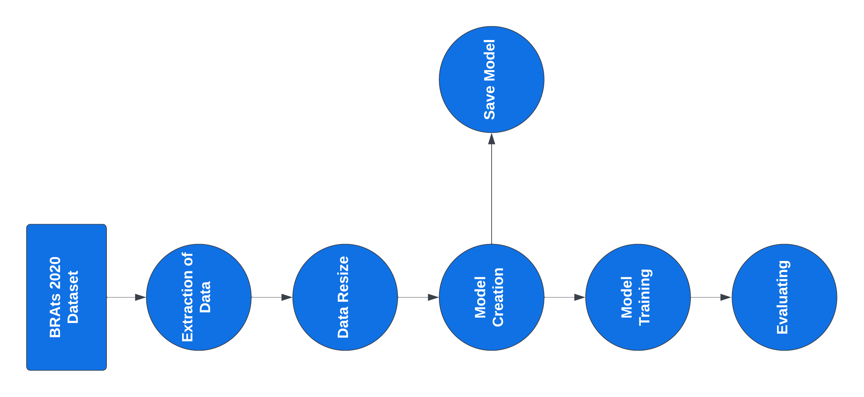
OPTIMIZED U-NET ARCHITECTURE OF BRAIN TUMOR SEGMENTATION
Department of Computer Science & Engineering
School of Computing
1156CS601 – MINOR PROJECT
WINTER SEMESTER 2022-2023
ABSTRACT
INTRODUCTION
RESULTS
STANDARDS AND POLICIES
Brain cancer is a fatal disease with little chance of survival. One of the most important tasks of neurologists and radiologists is detecting brain tumors.
Brain tumors can be benign (noncancerous) or malignant (cancerous) which affects adults and children. However, whether a brain tumor is cancerous or not, it can affect how the brain works if it becomes large enough to compress surrounding tissue.
MRI is the most common method for diagnosing brain tumors. Brain tumor segmentation using the U-Net uses more layered structure to autonomously and accurately determine the size and location of brain tumors from MRI.
Over the past few decades, the field of medical imaging has undergone a revolution with the application of machine learning and deep learning algorithms for the segmentation, identification, and prediction of patient survival from tumors or other diseases. In addition, it helps doctors make an early diagnosis of malignant brain tumors, thus improving the prognosis. Gliomas occur most often in adults and are thought to arise from glial cells and invade adjacent tissues.
The primary brain tumor is a glioma. High-Grade Glioblastoma (HGG) and Low-Grade Glioblastoma (LGG) are two other subtypes of glioma. While radiologists manually reviewed Magnetic Resonance Imaging (MRI) modalities to generate quantitative information, segmentation of 2D modalities is cumbersome, with variations and errors.
This challenge is further heightened if tumors vary in size, shape, and location. Tumor-like cells can appear anywhere in brain tissue and can vary in size, appearance, and shape, and it is difficult to automatically segment brain tumors and their subregions.
The proposed system is a U-Net architecture for brain tumor segmentation which used the BraTS 2020 dataset of the patient which is maintained privately. This model provides an accuracy of nearly 99 percent which is much greater than the existing system CNN. As U-Net is specially designed for medical usage, it gives more advantages for the training and validation phase.
Kaggle
Kaggle is a popular online platform for data scientists and machine learning professionals to participate in data science competitions, collaborate with others, and learn from other experts in the field. Kaggle hosts a variety of data science challenges that provide participants with datasets and specific tasks to solve. Classification or Regression. Participants can submit their solutions and receive a score based on their model’s performance on the hosted test dataset.
Standard Used: ISO/IEC 27001
CONCLUSIONS
The U-Net architecture has shown promising results in the task of brain tumor segmentation for the BraTS 2020 dataset. The BraTS 2020 dataset contains multi-modal MRI scans of brain tumors and corresponding segmentation masks, making it a challenging dataset for segmentation tasks. It included scans of 769 patients, including high-grade glioma (HGG) and low-grade glioma (LGG). The data were divided into a training subset and a validation subset, with 369 patients in the training subset and 400 patients in the validation subset. However, U-Net has been shown to achieve state-of-the-art performance in this task, achieving high accuracy and Dice similarity coefficient (DSC) scores. The U-Net architecture has the ability to handle the complex shape and texture of the tumor, its ability to handle multi-modal MRI scans, and its ability to segment the tumor region with high accuracy. The resulting accuracy of our model is around 99 percent.
METHODOLOGIES
To ensure that the input data to the model is clean and accurate. The preprocessed image is then divided into two sets – the training set and the validation set. The training set is used to train the UNet model, while the validation set is used to evaluate the performance of the model during training. The model is first initialized with random weights, and then the weights are updated using back propagation to minimize the loss function. The loss function measures the difference between the predicted segmentation and the ground truth segmentation. During the training process, the model is evaluated on the validation set to monitor its performance. The performance of the model is typically measured using metrics such as accuracy, precision, recall, and Dice score. Once the model is trained, it can be used to segment brain tumors in new medical images. The testing process involves passing the new image through the trained model and obtaining the predicted segmentation.
Figure 1. General Architecture
TEAM MEMBER DETAILS
<Logeshwaran K S VTU15366>
<Satwika B VTU15368>
<Fazel Khan P VTU17589>
<7092200602>
<6369038995>
<95159 52206>
<vtu15366@veltech.edu.in>
< vtu15368@veltech.edu.in>
< vtu17589@veltech.edu.in>
ACKNOWLEDGEMENT
Supervisor Name : Saran Raj S
Supervisor Contact No : 8122535491
Supervisor Mail : saranraj@veltech.edu.in
Figure 2. Dataflow Diagram.

